Slide 1
Strings

Slide 2
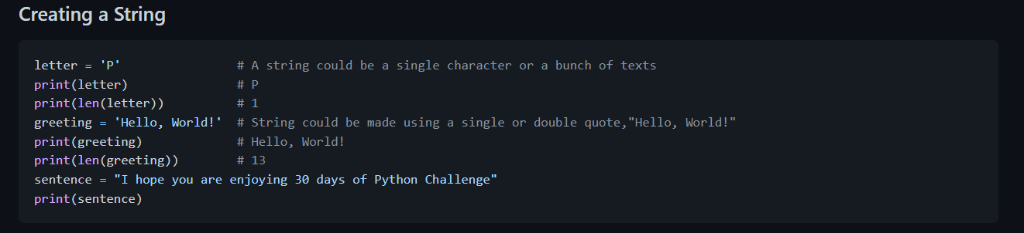
Strings
Text is a string data type. Any data type written as text is a string. Any data under single, double or triple quote are strings. There are different string methods and built-in functions to deal with string data types. To check the length of a string use the len() method.

Slide 3
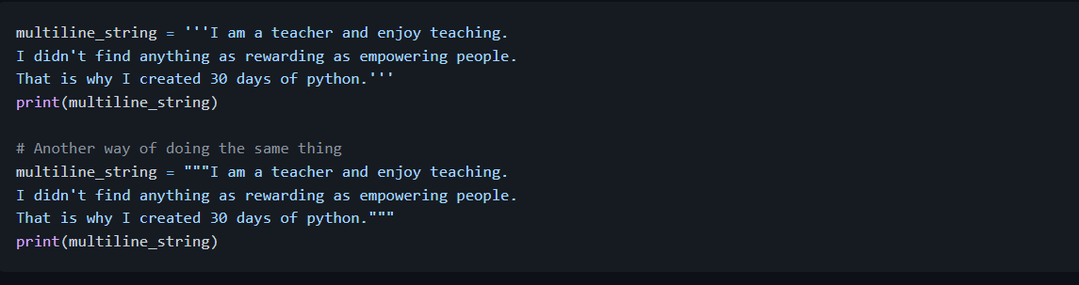
Multiline string is created by using triple single (''') or triple double quotes ("""). See the example below.

Slide 4
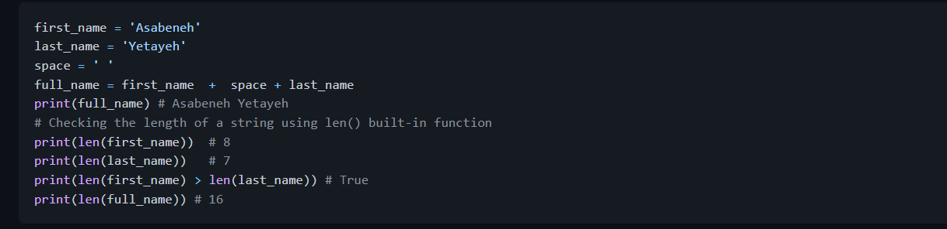
String Concatenation
We can connect strings together. Merging or connecting strings is called concatenation. See the example below:

Slide 5
Escape Sequences in Strings
In Python and other programming languages\followed by a character is an escape sequence. Let us see the most common escape characters:
\n: new line
\t: Tab means(8 spaces)
\\: Back slash
\': Single quote (')
\": Double quote (")
\r: carriage return(next line without gap)

Slide 6
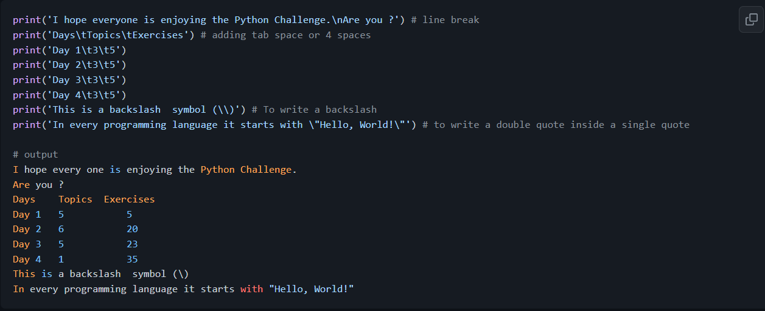
Now, let us see the use of the above escape sequences with examples.

Slide 7
String formatting
Old Style String Formatting (% Operator)
In Python there are many ways of formatting strings. In this section, we will cover some of them. The "%" operator is used to format a set of variables enclosed in a "tuple" (a fixed size list), together with a format string, which contains normal text together with "argument specifiers", special symbols like "%s", "%d", "%f", "%.number of digitsf".
%s - String (or any object with a string representation, like numbers)
%d - Integers
%f - Floating point numbers
"%.number of digitsf" - Floating point numbers with fixed precision

Slide 8
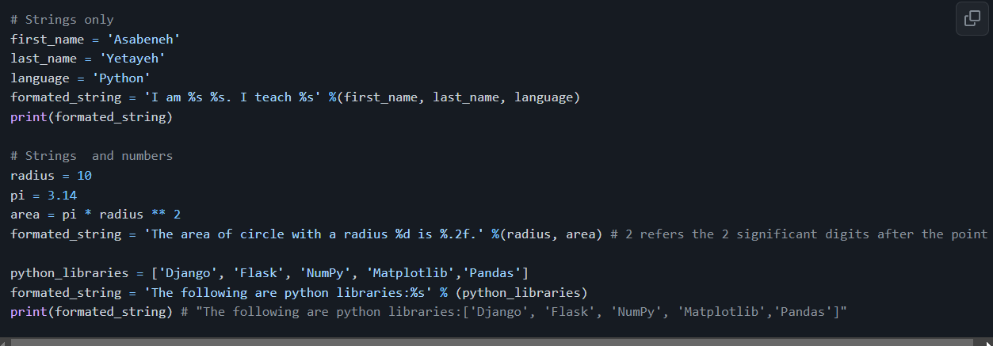

Slide 9
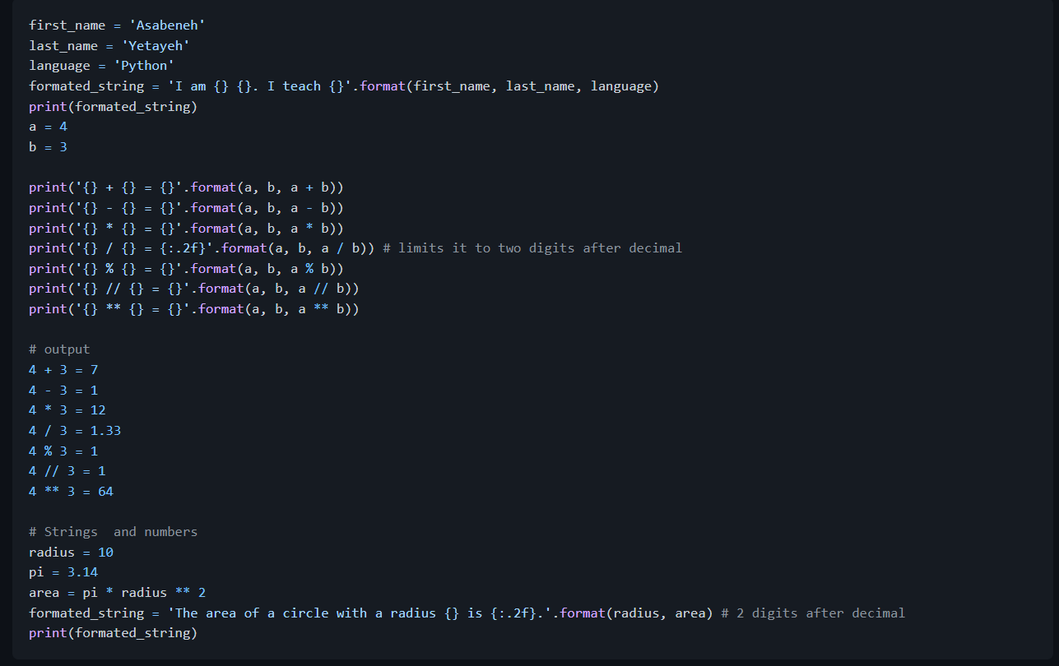
New Style String Formatting (str.format)
This formatting is introduced in Python version 3.

Slide 10
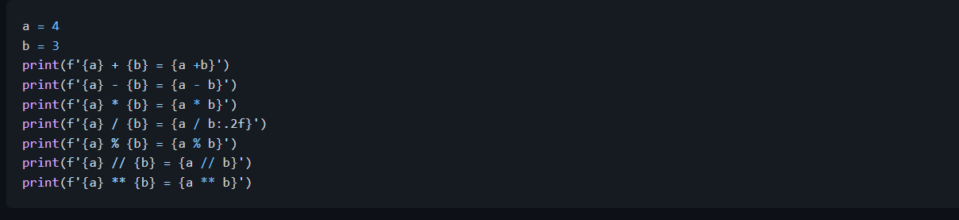
String Interpolation / f-Strings (Python 3.6+)
Another new string formatting is string interpolation, f-strings. Strings start with f and we can inject the data in their corresponding positions.

Slide 11
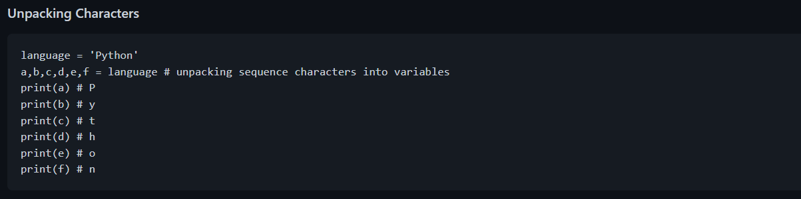
Python Strings as Sequences of Characters
Python strings are sequences of characters, and share their basic methods of access with other Python ordered sequences of objects – lists and tuples. The simplest way of extracting single characters from strings (and individual members from any sequence) is to unpack them into corresponding variables.

Slide 12
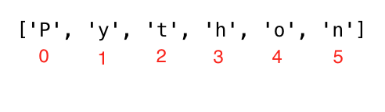
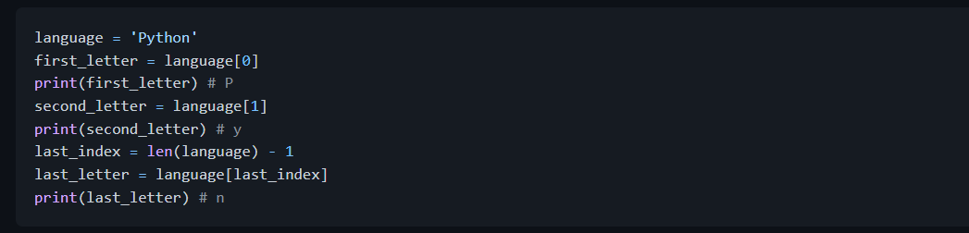
Accessing Characters in Strings by Index
In programming counting starts from zero. Therefore the first letter of a string is at zero index and the last letter of a string is the length of a string minus one.

Slide 13
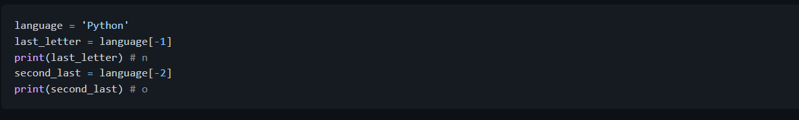
If we want to start from right end we can use negative indexing. -1 is the last index.

Slide 14
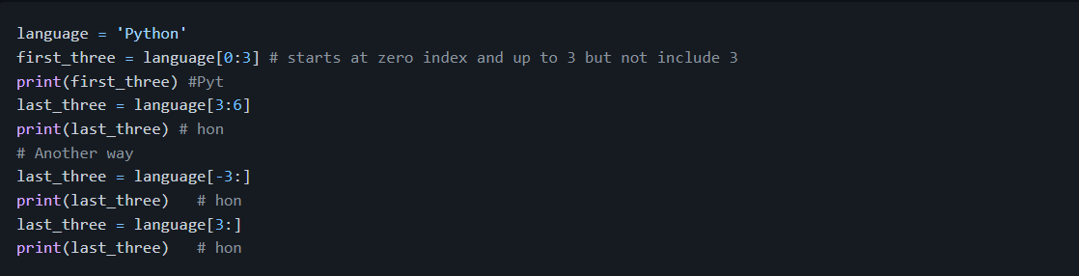
Slicing Python Strings
In python we can slice strings into substrings.

Slide 15
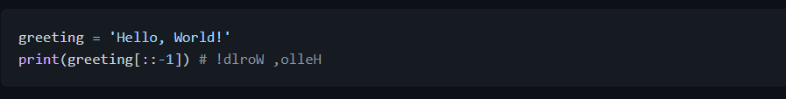
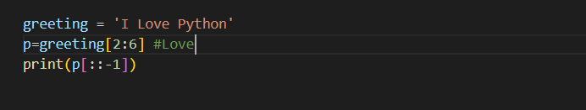
Reversing a String Reversing a Word in a String
We can easily reverse strings in python.

Slide 16
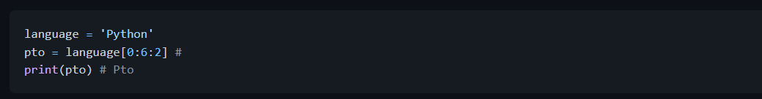
Skipping Characters While Slicing
It is possible to skip characters while slicing by passing step argument to slice method.

Slide 17
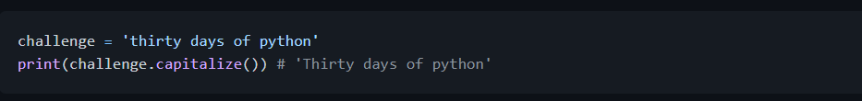
String Methods
There are many string methods which allow us to format strings. See some of the string methods in the following example:
capitalize(): Converts the first character of the string to capital letter
count(): returns occurrences of substring in string, count(substring, start=.., end=..). The start is a starting indexing for counting and end is the last index to count.

Slide 18
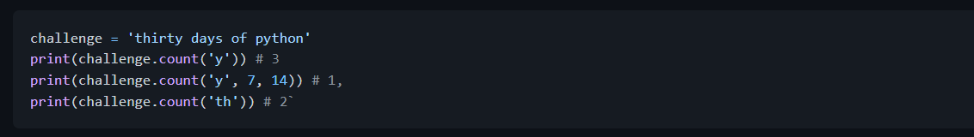
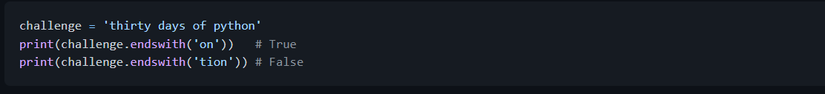
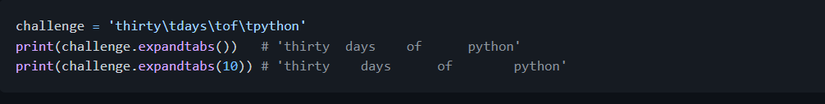
endswith(): Checks if a string ends with a specified ending
expandtabs(): Replaces tab character with spaces, default tab size is 8. It takes tab size argument

Slide 19
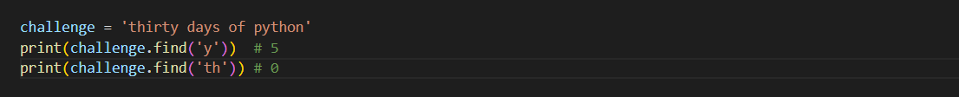
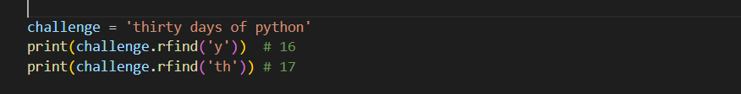
find(): Returns the index of the first occurrence of a substring, if not found returns -1
rfind(): Returns the index of the last occurrence of a substring, if not found returns -1

Slide 20
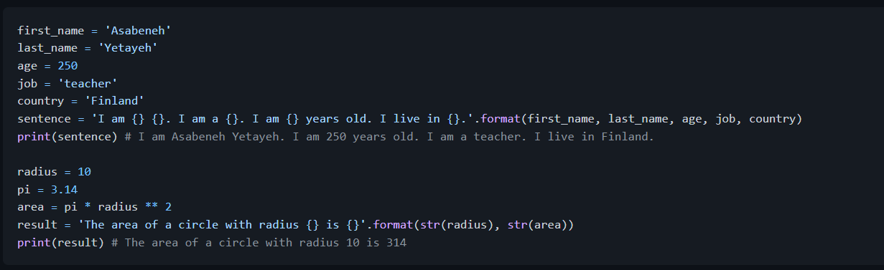
format(): formats string into a nicer output More about string formatting check this: (https://www.programiz.com/python-programming/methods/string/format)

Slide 21
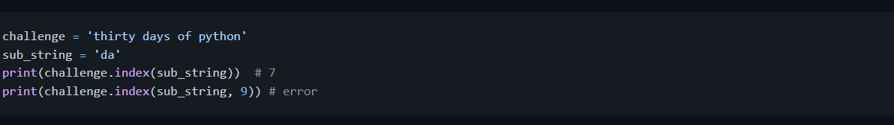
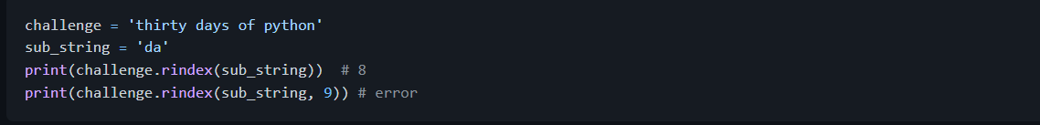
index(): Returns the lowest index of a substring, additional arguments indicate starting and ending index (default 0 and string length - 1). If the substring is not found it raises a valueError.
rindex(): Returns the highest index of a substring, additional arguments indicate starting and ending index (default 0 and string length - 1)

Slide 22
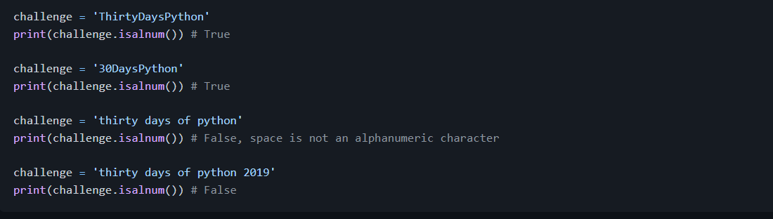
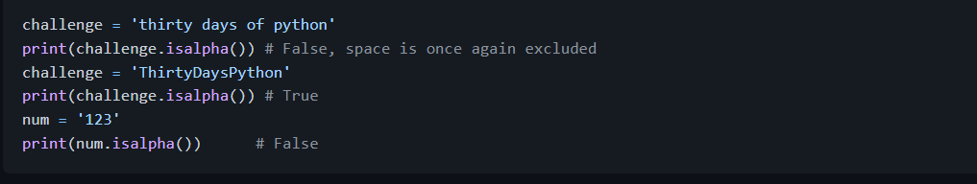
isalnum(): Checks alphanumeric character
isalpha(): Checks if all string elements are alphabet characters (a-z and A-Z)

Slide 23
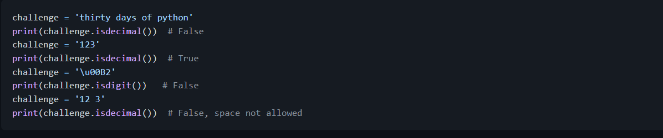
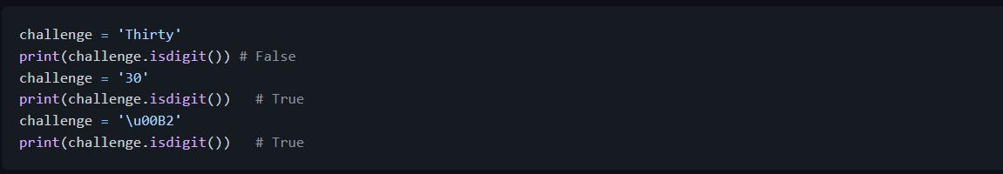
isdecimal(): Checks if all characters in a string are decimal (0-9)
isdigit(): Checks if all characters in a string are numbers (0-9 and some other unicode characters for numbers)

Slide 24
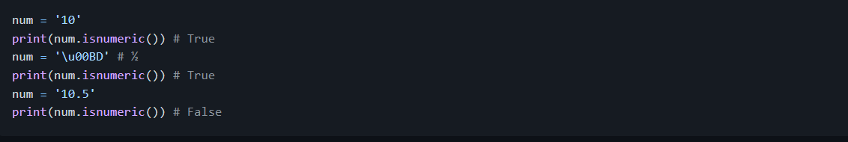
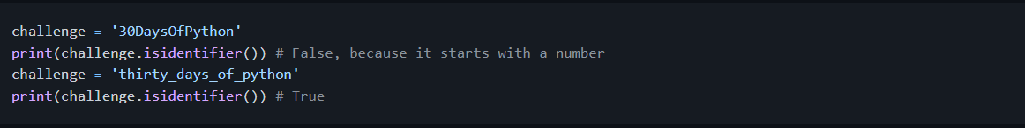
isnumeric(): Checks if all characters in a string are numbers or number related (just like isdigit(), just accepts more symbols, like ½)
isidentifier(): Checks for a valid identifier - it checks if a string is a valid variable name

Slide 25
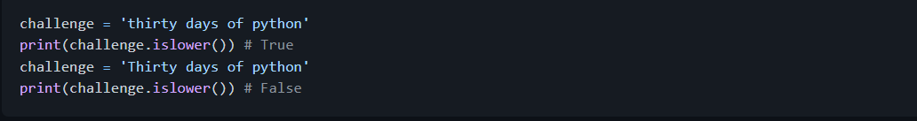
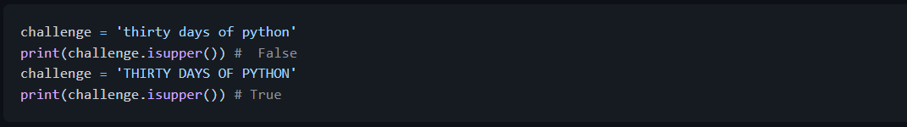
islower(): Checks if all alphabet characters in the string are lowercase
isupper(): Checks if all alphabet characters in the string are uppercase

Slide 26
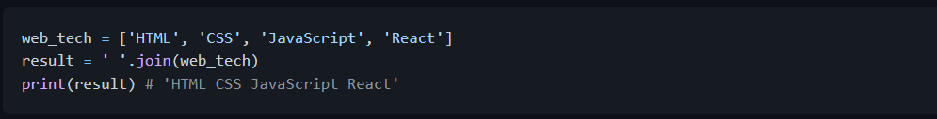
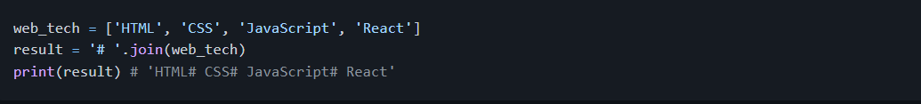

join(): Returns a concatenated string
strip(): Removes all given characters starting from the beginning and end of the string

Slide 27
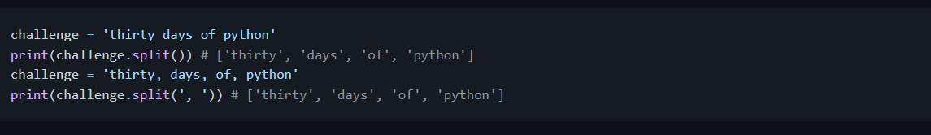

replace(): Replaces substring with a given string
split(): Splits the string, using given string or space as a separator
title(): Returns a title cased string

Slide 28
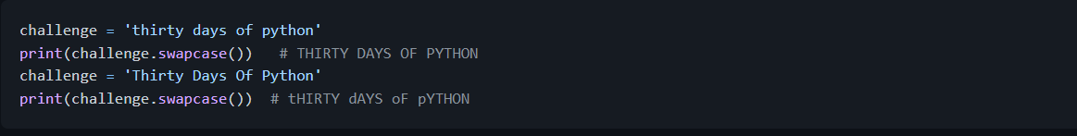
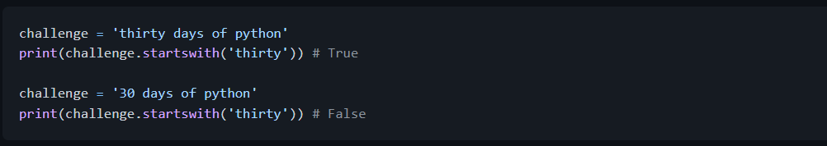
swapcase(): Converts all uppercase characters to lowercase and all lowercase characters to uppercase characters
startswith(): Checks if String Starts with the Specified String
🌕 You are an extraordinary person and you have a remarkable potential. You have just completed day 4 challenges and you are four steps a head in to your way to greatness. Now do some exercises for your brain and muscles.

Slide 29
Exercises - Day 4
Concatenate the string 'Thirty', 'Days', 'Of', 'Python' to a single string, 'Thirty Days Of Python'.
Concatenate the string 'Coding', 'For' , 'All' to a single string, 'Coding For All'.
Declare a variable named company and assign it to an initial value "Coding For All".
Print the variable company using print().
Print the length of the company string using len() method and print().

Slide 30
Change all the characters to uppercase letters using upper() method.
Change all the characters to lowercase letters using lower() method.
Use capitalize(), title(), swapcase() methods to format the value of the string Coding For All.
Cut(slice) out the first word of Coding For All string.
Check if Coding For All string contains a word Coding using the method index, find or other methods.
Replace the word coding in the string 'Coding For All' to Python.
Change Python for Everyone to Python for All using the replace method or other methods.
Split the string 'Coding For All' using space as the separator (split()) .
"Facebook, Google, Microsoft, Apple, IBM, Oracle, Amazon" split the string at the comma.

Slide 31
What is the character at index 0 in the string Coding For All.
What is the last index of the string Coding For All.
What character is at index 10 in "Coding For All" string.
Create an acronym or an abbreviation for the name 'Python For Everyone'.
Create an acronym or an abbreviation for the name 'Coding For All'.
Use index to determine the position of the first occurrence of C in Coding For All.
Use index to determine the position of the first occurrence of F in Coding For All.
Use rfind to determine the position of the last occurrence of l in Coding For All People.
Use index or find to find the position of the first occurrence of the word 'because' in the following sentence: 'You cannot end a sentence with because because because is a conjunction'

Slide 32
Use rindex to find the position of the last occurrence of the word because in the following sentence: 'You cannot end a sentence with because because because is a conjunction'
Slice out the phrase 'because because because' in the following sentence: 'You cannot end a sentence with because because because is a conjunction'
Find the position of the first occurrence of the word 'because' in the following sentence: 'You cannot end a sentence with because because because is a conjunction'
Slice out the phrase 'because because because' in the following sentence: 'You cannot end a sentence with because because because is a conjunction'
Does ''Coding For All' start with a substring Coding?
Does 'Coding For All' end with a substring coding?
' Coding For All ' , remove the left and right trailing spaces in the given string.

Slide 33

Which one of the following variables return True when we use the method isidentifier():
30DaysOfPython
thirty_days_of_python
The following list contains the names of some of python libraries: ['Django', 'Flask', 'Bottle', 'Pyramid', 'Falcon']. Join the list with a hash with space string.
Use the new line escape sequence to separate the following sentences
Use a tab escape sequence to write the following lines.

Slide 34
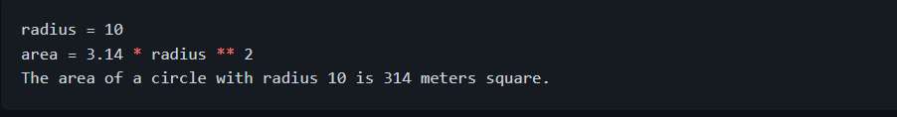
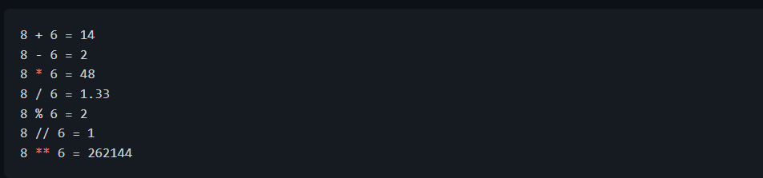
Use the string formatting method to display the following:
Make the following using string formatting methods:

